Slide 1
Wilderness GPS Navigation
Olympia Navigation Committee
The Mountaineers
Rev 5, Jan 18, 2016

Slide 2
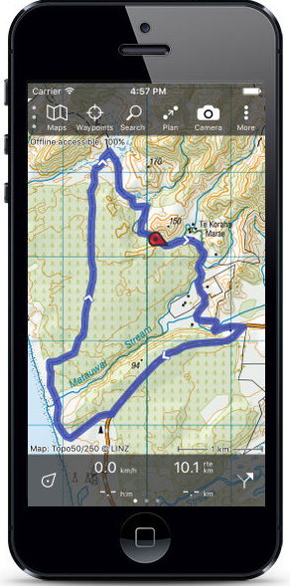
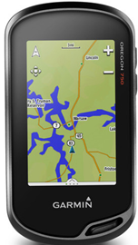
What I Might Discuss …
GPS System overview
Common Accuracy Issues
Devices: Smartphone vs Dedicated
Use: waypoints, routes vs tracks, pre-trip
Layers: Maps, Images, etc
Nav Tools for Survival
Preparing for this weekend’s field trip
On-line tools
Notes:
Rough timeline:
6:30 Intros
6:40 start presentation
7:45 break
8:00 start exercises
9:00 regroup, final questions
Mention that presentation will be sent out after class – a PDF is in the GPS class document folder on Mountaineers.org

Slide 3
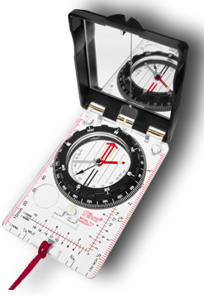
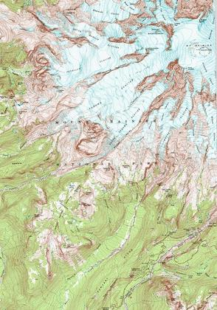
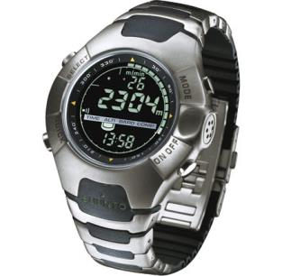
If You Remember Nothing Else ...
Trust, But Verify - GPS works best when used with a brain.
GPS works together with Map, Compass, Altimeter - It doesn’t replace them.
Map
Compass
Altimeter
GPS
Brain

Slide 4
GPS Device can provide ...
Moving map centered on user
Location, Bearings, Routes, Elevation
Record Tracks
Distance & Elevation calculations
Multiple maps, layers, images, etc
Digital compass
Audible alerts to locations, altitudes, time
A GPS is a: Map, Compass, Altimeter, Clock, ...

Slide 5
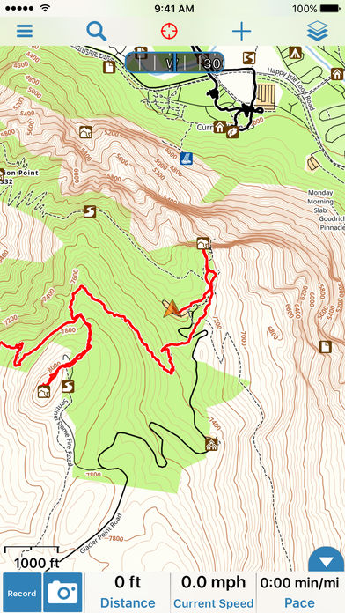
What More Could you Want??
A Topo Map that:
Always knows where you are
Points where you should go
Leads you along a path
Tells you how far you’ve gone and have yet to go.
(And maybe: calendar, horoscopes, celebrity gossip, food reviews, games, …) And it fits in your pocket!
(Why am I taking Navigation if this thing exists???)

Slide 6
So Why Isn’t GPS All I Need?
Electronics are Unreliable!
Batteries, Diabolical Gremlins of Software, Operator Error, etc
Digital compasses require unpredictable re-calibration (often don’t work when you need them)
Insufficient power for continuous operation
Don’t trust just one tool
Some things are hard with GPS, easy with compass (eg: intersections of bearings, etc)

Slide 7
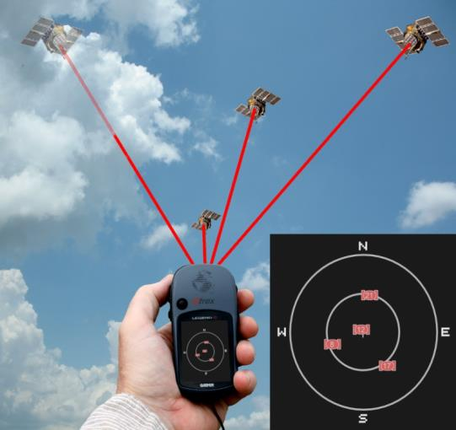
How does GPS Work?
24 sateliites in 12,550 mile altitude orbit (not geo-synchronous)
Satellites are continuously transmitting the current time and orbit information.
The GPS receiver calculates Time of Flight (TOF) of the signal from the satellite to the receiver.
The distance to the satellite can be calculated from the TOF.
Notes:
Time of flight is approx 0.07 seconds, very small time differences.
Orbital height is 20,180 km (12,540 mi). 12540/186000 (c)= 0.067 seconds

Slide 8
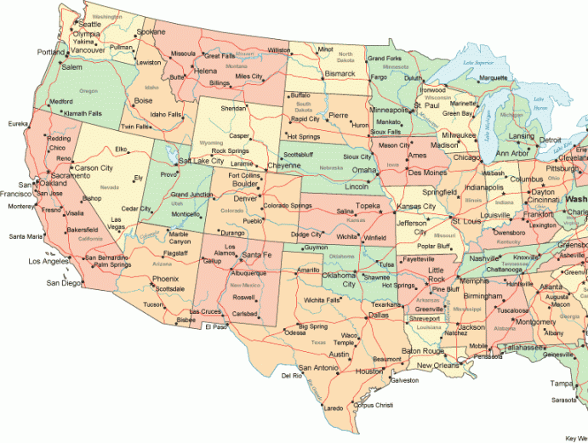
1028 km from Boise
1125 km from Minneapolis
Denver!
943 km from Phoenix
Where are we?
Notes:
With three satellites (circles), the location can be pointed to one location where all three cross. To get altitude, we need a fourth satellite signal.

Slide 9
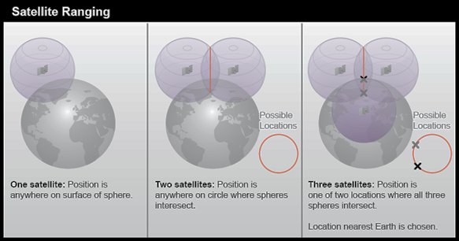
But really, we need to think about Spheres: Ideally, Four Satellites With Dispersed Positions
Notes:
GPS uses triangulation, same concept as triangulation on a map. 4 satellites are needed because it is triangulating in 3D space (position and altitude).
The fourth satellite is for “trilateration”. Three can get you to two points, but one is usually out in space (i.e.. Two points at different altitudes). Fourth helps calculate a timing correction. It’s placing you at an intersection of circle X, Y, Z, and TIME. (fourth satellite reduces clock variability)
US Air Force used to have ability to degrade GPS accuracy, they claim to have disabled this functionality but its just software…

Slide 10
GPS Receivers ONLY need Satellite signals
No need for WiFi, Cellular, or other signals
GPS only calculates position (including altitude)
Using position, device and software computes:
Speed, Direction of travel
Routes, Tracks
Etc.

Slide 11
Common Accuracy Issues
Restricted View of Sky (can’t find satellites)
Reflected Signals (multipath)
Atmospheric Conditions
No Orbit Information
GPS is Usually Reliable so Errors can Surprise you. (Hint: Use your Brain)
Notes:
[McClure Rev. 6-22-15]

Slide 12
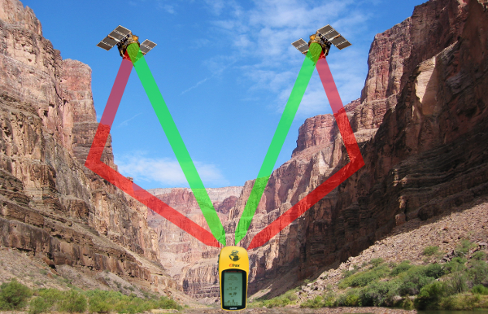
Signal Reflections - Multipath
Signals reflect off of buildings or canyons, which increases Time of Flight, creating error
Notes:
Red signals take longer to get to the GPS, so it think the distance to the satellite is further than is actually is.

Slide 13
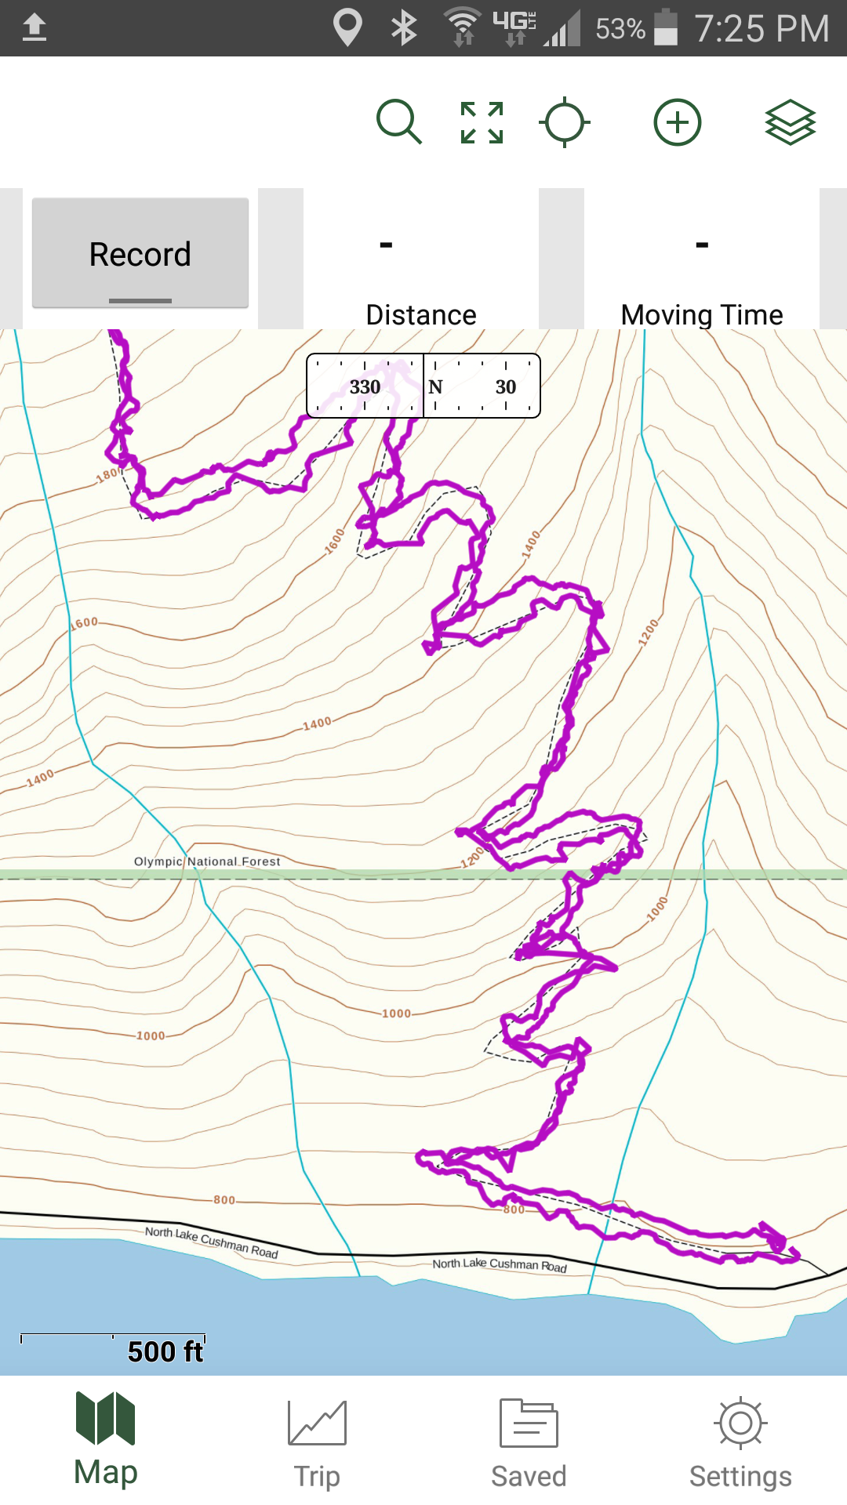
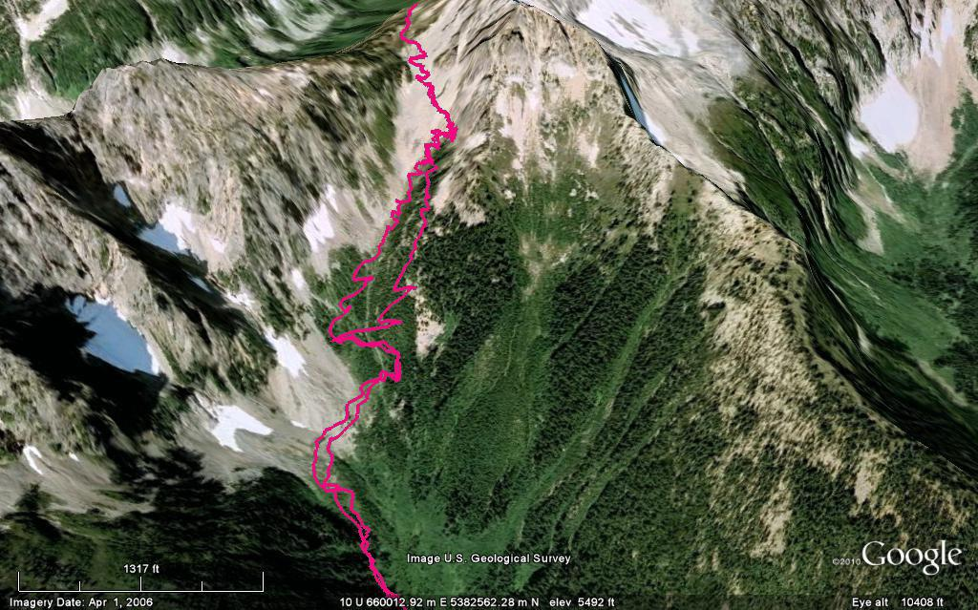
Position errors: Same trail both directions – GPS shows 2 tracks
Notes:
Same trail up and down, GPS shows two tracks when in the gully.

Slide 14
Battery Management
Battery Life = few hours to full week, depending on use.
To Track or Not?
Tracking and Screen Use are the largest power drains.
Conserving Power
Start with full battery
Keep the phone warm
Airplane mode
Turn off all other apps
Dim screen
Carry Spare Batteries or charging unit!
Notes:
-Issue with solar chargers – phone’s screen turn on when a charger is connected or disconnected, so a solar charger when walking may actually drain the battery faster. It’s best to charge an external battery, then use that to charge the phone.

Slide 15
GPS Concepts: Waypoints
Waypoints are coordinates that identify a point on the ground.
Mark Key Locations - “Leave Trail”, “Descent Gully”, “Beer & Pizza”, etc
GoTo Function - Use with compass to increase battery & convenience
Create Routes - Sequences of waypoints

Slide 16
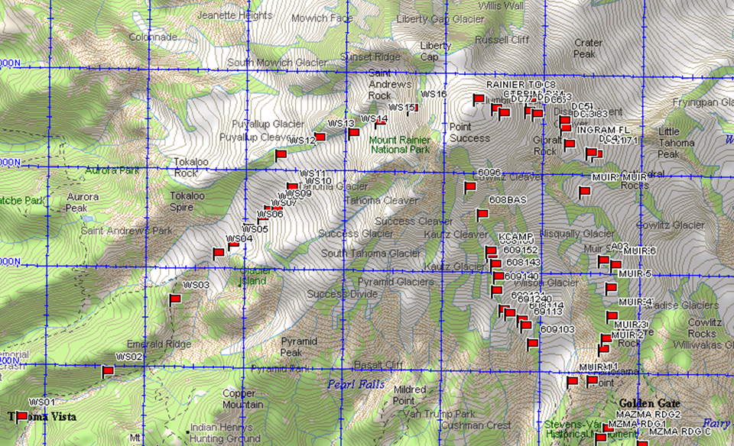

Slide 17
Tracks vs Routes
Tracks are “breadcrumbs” - showing your actual path (to accuracy of GPS)
Routes are sequences of waypoints
[OPINION: Routes are Useless!]
Tracking is extremely valuable, but power-hungry
Tracks can be shared, BUT … Downloaded tracks are often “conceptual”, not real
Tracks are shared as GPX Files
[ gpx = GPS eXchange format ]

Slide 18
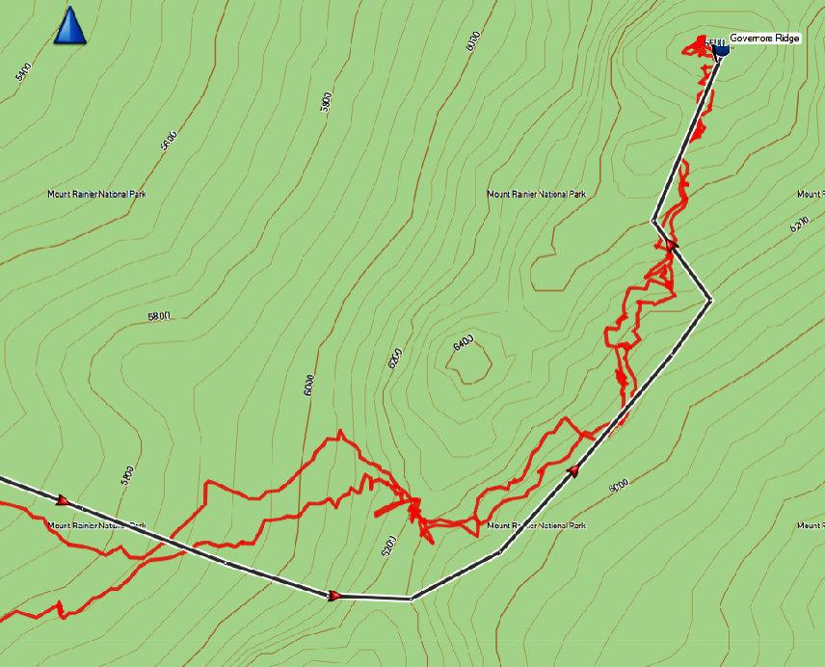
Actual vs Conceptual Tracks

Slide 19
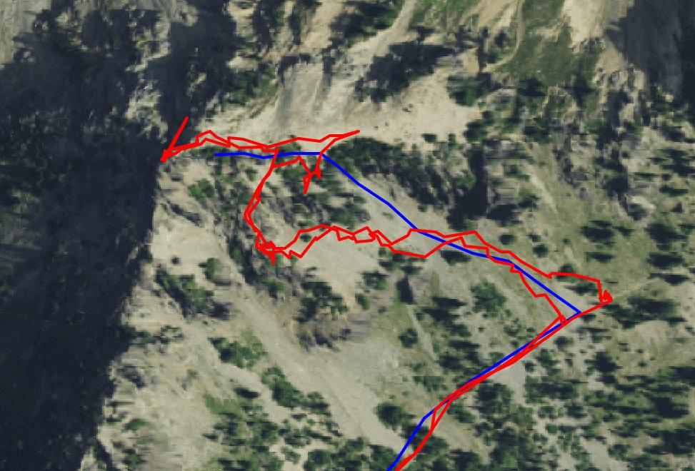
Another example: 3 Way Peak

Slide 20
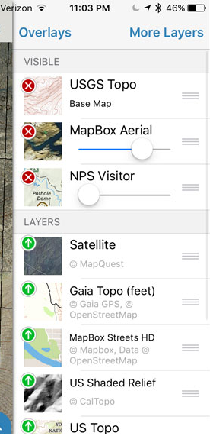
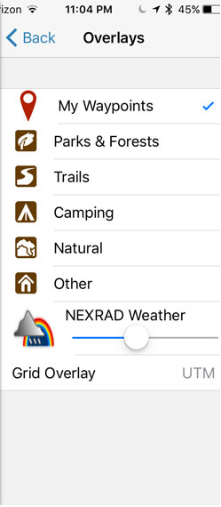
Layers - Loadable Maps, Images, etc
Base and specialized maps - boundaries, camping, etc
Aerial and Satellite images
Download Maps BEFORE your trip!
Can create your own overlays (using Google Earth, etc)
Not all Maps have Altitude info
Datums need to match

Slide 21
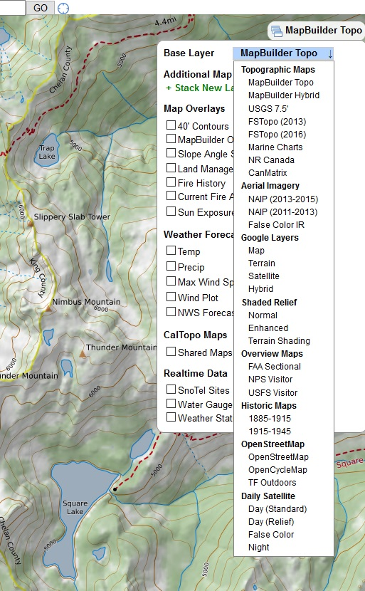
Pre-Trip Planning with Online Tools
Detailed Terrain Analysis
Aerial Photo “Fly-bys”
Political Boundaries
Current Conditions
Fire & seasonal closures, etc
Route Planning
Download Results to your Device
Cal Topo Gmap4
GaiaGPS.com Google Earth
Many more …
(More slides to come if we have time)
Notes:
Other tools? What have people used?

Slide 22
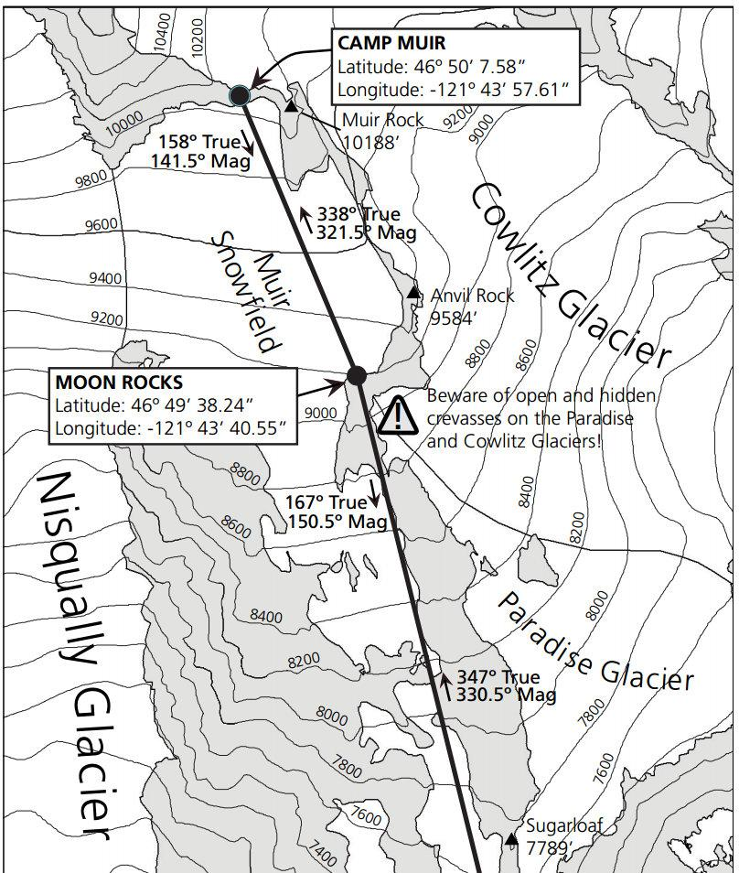
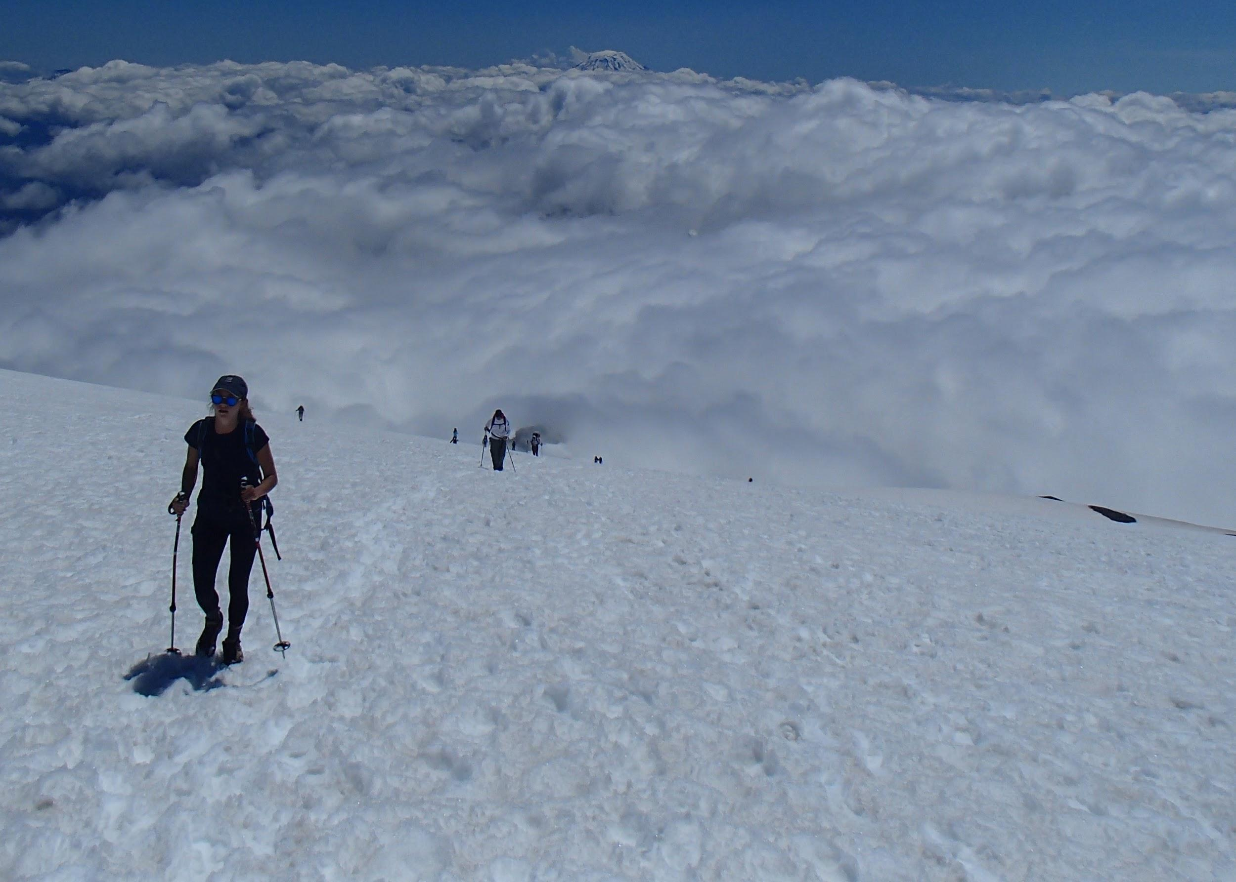
Integrating Nav Tools for Survival:
Muir Snow Field in Low Visibility
Nav Tools you will Want and Use!
Map
Compass
Altimeter
GPS - Points, Bearings, Tracks

Slide 23
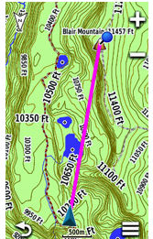
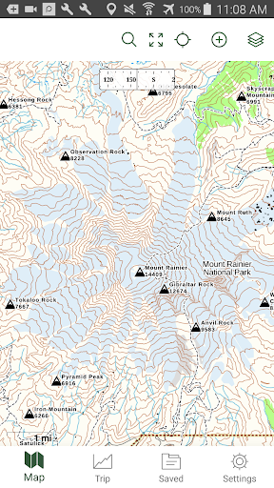
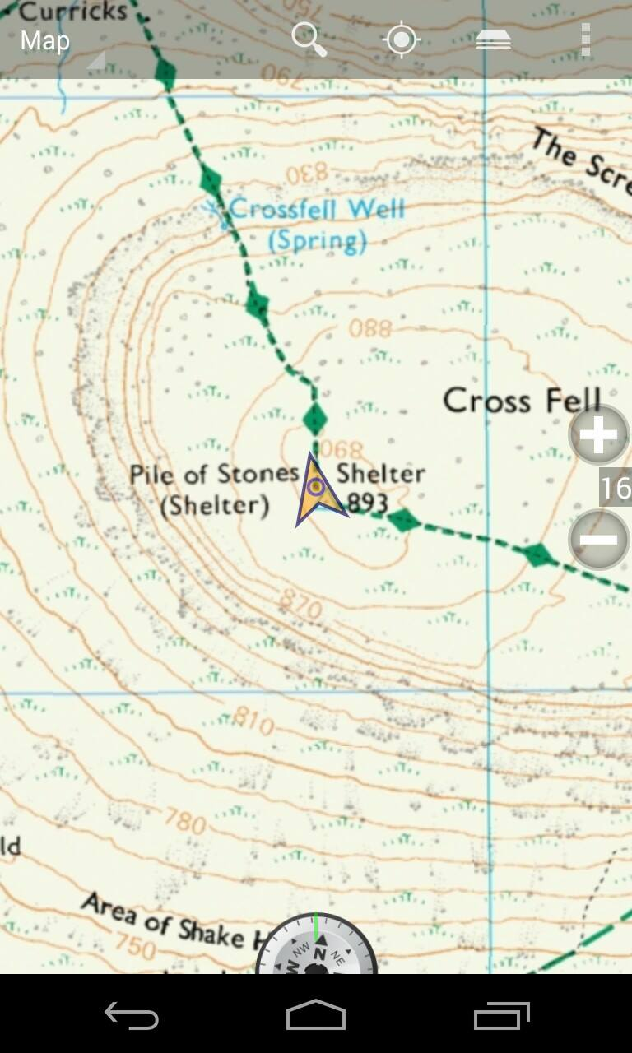
Field Exercises this weekend: We might be able to help you with...
Garmin (ie: Oregon 600)
GAIA GPS
Backcountry Navigator

Slide 24
Smartphone vs Dedicated Device
Vigorous debate = you decide for yourself
Advantages
Smart Phone App | Dedicated/Handheld GPS
Much Less Expensive | Better Battery-Life & Spares
You already carry phone (no weight) | Weather & Shock Proof (hopefully)
Larger, Better Screen | Better Reliability, & (in theory) Accuracy
Huge Numbers of Maps & Images | Huge Numbers of Maps & Images

Slide 25
Field Exercise Prep for Sat or Sun
Optional: Install GAIA or other GPS App
Download map covering Kennedy Creek area (Before you leave today, have an off-line map loaded.)
GPS exercises will be in small groups or optional.

Slide 32
Did I mention that these all work together?
Brain
Compass
Map
GPS
Altimeter

Slide 33
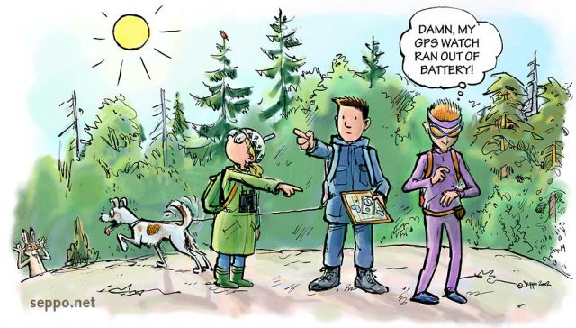
END

